Slide 1
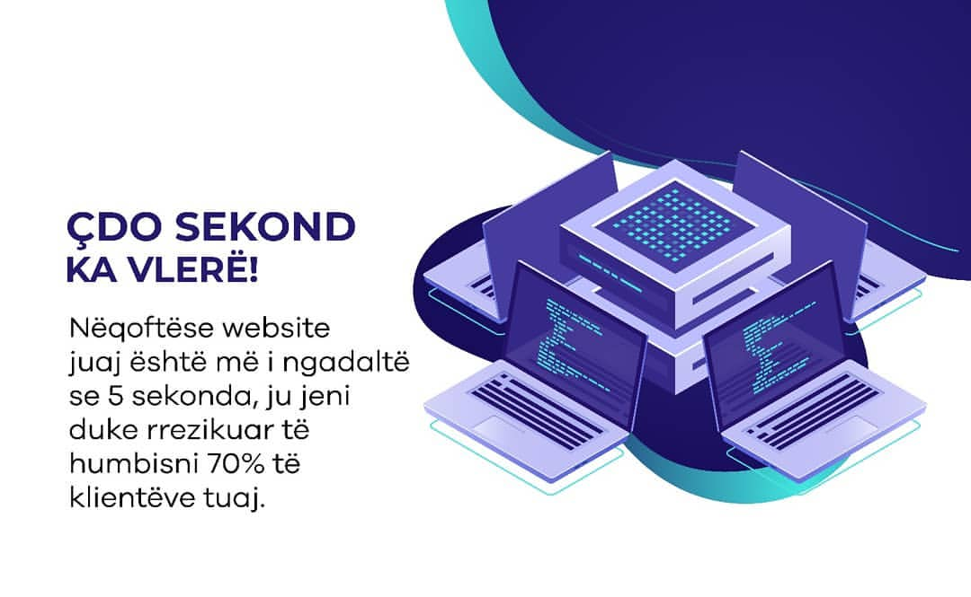


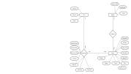
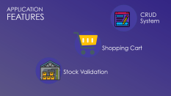




David | Fakhrizal | Rivaldy
BALJID
Game Store
Using Java Application & Sql Server

Slide 2


What is Java?
What is
SQL Server?

Slide 3
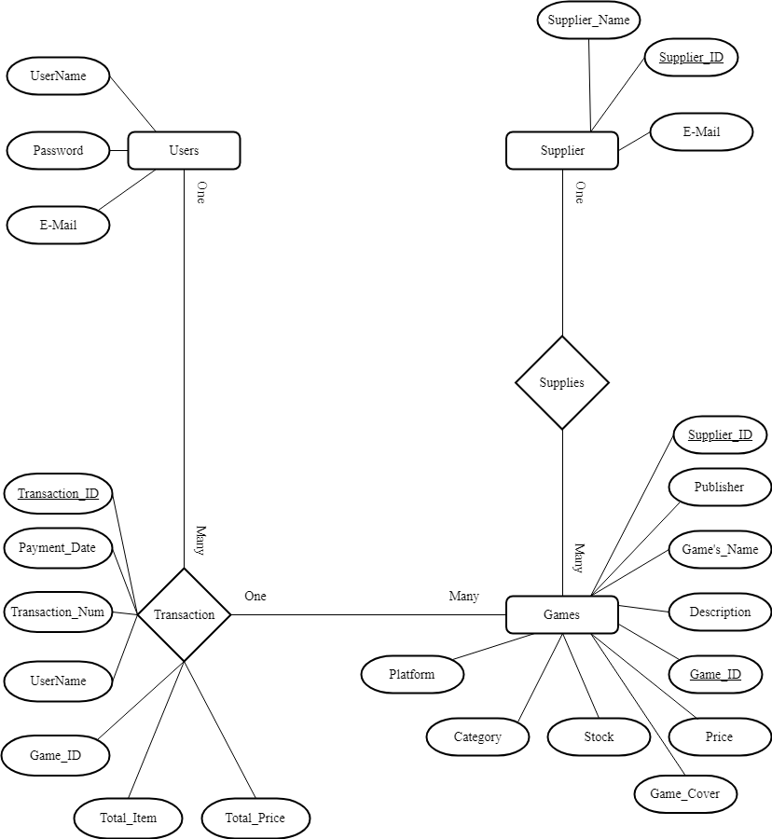
ERD DIAGRAM

Slide 4



APPLICATION FEATURES
CRUD
System
Shopping Cart
Stock Validation

Slide 5
David | Fakhrizal | Rivaldy
Thank You
BALJID
Game Store
Using Java Application & Sql Server

